Slide 1
A Study in Extensible Algorithmic Thinking
First-Year Project by Andrew Nam
Notes:
Last time, I introduced the topic of Sudoku and presented on some thoughts about modeling fungibility and attention. Today, I want to present a snapshot of the progress since that as it has developed more formally into my FYP. The project is still in development including the experimental design so please feel free to input any comments and criticisms that might help improve the study. Lastly, there is a demo of the application that I will be deploying for this experiment. If you have your laptop, feel free to open the application and follow along when we get to the demo portion. I would appreciate any feedback on the application as well.

Slide 2
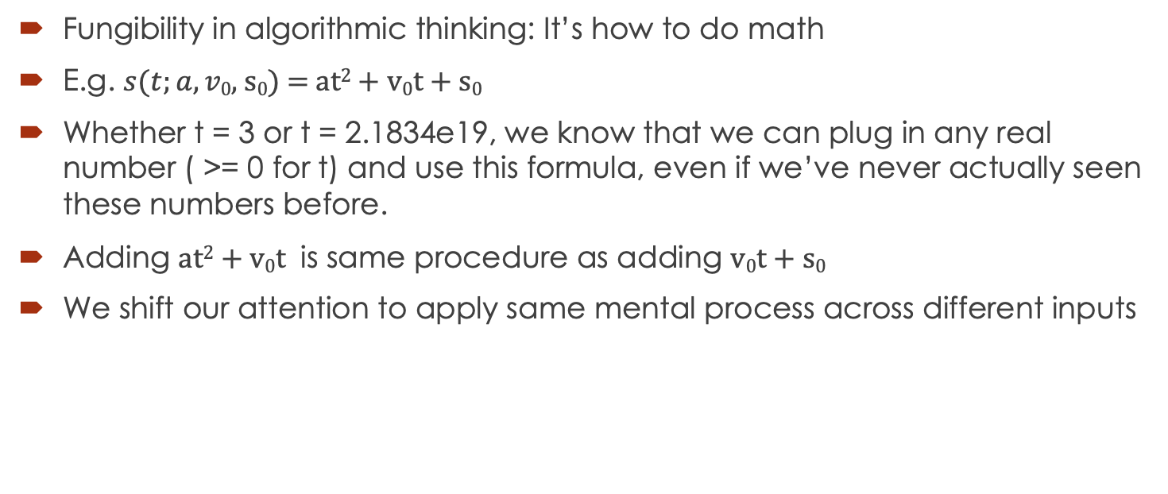
Extensibility of Human Reasoning
Fungibility in algorithmic thinking: It’s how to do math
E.g. $s(t;a,v\text{0}\text{, }\text{s}\text{0}\text{) = }\text{at}\text{2}\text{ + }\text{v}\text{0}\text{t}\text{ + }\text{s}\text{0}$
Whether t = 3 or t = 2.1834e19, we know that we can plug in any real number ( >= 0 for t) and use this formula, even if we’ve never actually seen these numbers before.
Adding $\text{at}\text{2}\text{ + }\text{v}\text{0}\text{t}$ is same procedure as adding $\text{v}\text{0}\text{t}\text{ + }\text{s}\text{0}$
We shift our attention to apply same mental process across different inputs
Notes:
As the study title suggests, I am interested in what I called fungibility, also known as variable binding in other computational modeling contexts. For example

Slide 3
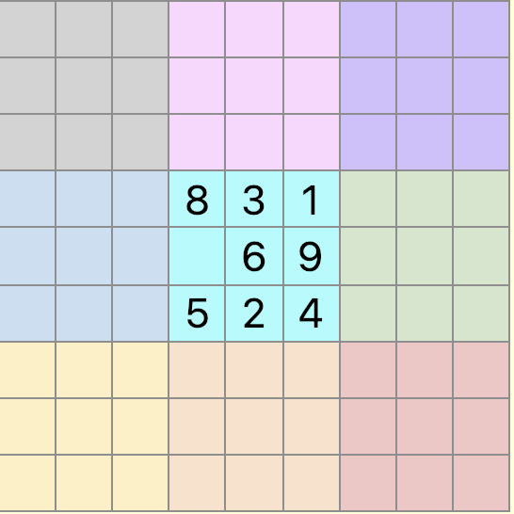
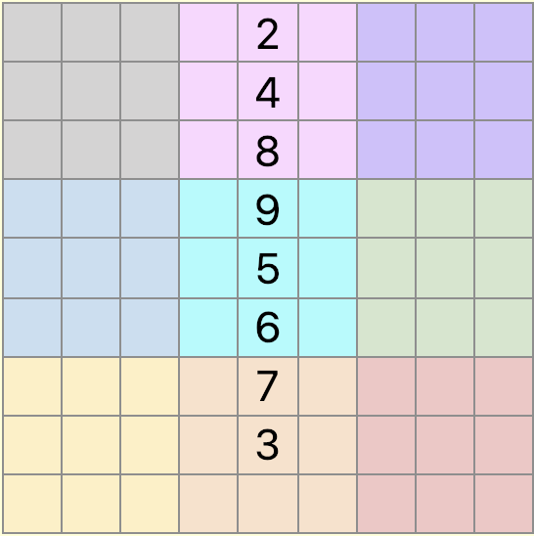
Using Sudoku
A Sudoku grid is a 9x9 grid of numbers where each row, column, and 3x3 box must contain exactly one of each digit from 1 to 9.
A puzzle that cannot be solved without fungibility
Notes:
Recognizing that the missing cell in the cyan box in the left puzzle must be a 7 because that box already has all the other digits other than 7 is the exactly same procedure as recognizing that the missing cell in Column 5 in the right puzzle must be a 1 because that column has all the other digits other than 1. And even someone who’s never played Sudoku would have no problem solving a similar puzzle.
And while I'm sure any of us here could write some code that can do this in less than 15 minutes, yet this task remains incredibly difficult for neural networks.

Slide 4
Modern Neural Networks
Recurrent Relational Networks (Palm et al., 2018) – 96.6% test accuracy on 9x9 grids
My replication: 100% test accuracy on 4x4 grids, smaller dataset
So has it mastered fungibility?
Notes:
Seems to solve Sudoku puzzles really well. If Sudoku really does require fungibility, has it mastered that construct?

Slide 5
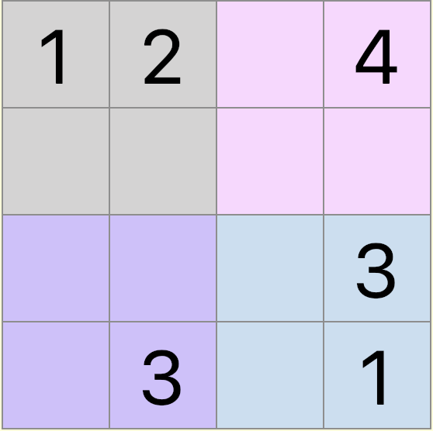
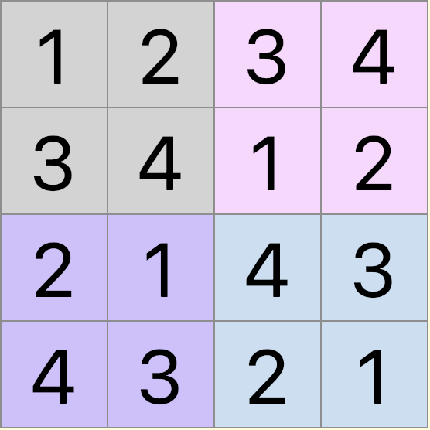
Digit Fungibility (Control)
Trained a network with puzzles with 6 hints
Tested on held-out puzzles with 6 hints: average accuracy of 16/16 correct cells
Notes:
In my replication, the model was able to solve 4x4 Sudoku grids given 6 hints at an average of nearly perfect scores for every test puzzle, that is 16 out 16 cells had correct digits.

Slide 6
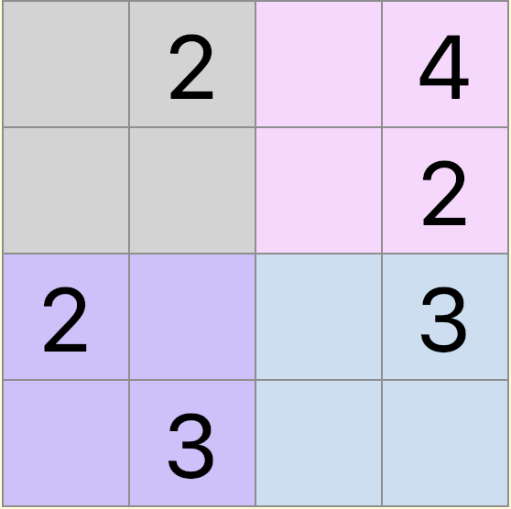
Digit Fungibility (No 1’s)
Trained a network with puzzles with 6 hints, but with no 1’s
Tested on held-out puzzles with 6 hints: average accuracy of 10/16 correct cells
Notes:
when the model was trained on puzzles that had no 1's in its hints and tested on puzzles that did, the average accuracy dropped to 10 out of 16 cells, or only 4 additional cells solved. It's not that the neural network did not know how to solve Sudoku, nor that it did not know how to incorporate a cell with a 1 at all since it would need to use it to get to the 16 out of 16 solution state, even if a 1 was not present with the hints.

Slide 7
What About People?
How do humans generalize across these forms of fungible tasks?
What kind of tasks are humans able to generalize problem solving to span the entire input/output domains even with very limited exemplars?
Notes:
And while this is all very interesting, that's enough about modeling as that's not what my first-year project is about. Because we get that neural networks struggle to do this, so what about people?

Slide 8
Experimental Design
Take participants who self-report that they have never successfully completed a Sudoku puzzle
Teach them the basics of Sudoku and a very simple technique of Full House where 8 digits already exist in a house and the missing cell is the missing digit.
Teach them a technique called a Hidden Single and test across various conditions where the problem becomes progressively more difficult.
Notes:
And while this is all very interesting, that's enough about modeling as that's not what my first-year project is about. Because we get that neural networks struggle to do this, so what about people?

Slide 9
Demo
http://52.53.232.113:3000/
Notes:
To make this more concrete, here is the actual application I've built for this task. Disclaimer: it's not yet complete and I am just now about to put it on MTurk Sandbox to start testing my experiment.
I would like for this to be a presentation of my research, a demo, and a pilot experiment all at once, so please feel free to try inputting incorrect responses, test the UI, critique any weird instructions, etc., but do keep it to what a typical MTurker would do (i.e. don't open console and break things. I haven't bothered to make things super hacker-proof).
First two screens are just introduction. You can skip them.
What is Sudoku? - Teaches the rules of Sudoku. Just a comprehension check. 9 is the correct answer by the way.
Technique: Full House - This is the slide I showed you in the powerpoint earlier. Skipping ahead
Technique: Hidden Single - This is where the participants learn the Hidden Single technique, which for all of you here I'm sure is trivially simple.
Hidden Single Puzzles: As you can see, there is a timer here. Feel free to go through these set of puzzles and I will explain what each of the puzzles were meant to test.

Slide 10
Hidden Single Tutorial
Number of hints: 6
Distractors: 0
House type: Row
House index: 3
Target cell index: 4
Hint locations
(2, 2), (3, 5), (3, 7)
(3, 8), (4, 5), (7, 5)
Target digit: 5

Slide 11
Hidden Single Puzzle 1 - Digit
Number of hints: 6
Distractors: 0
House type: Row
House index: 3
Target cell index: 4
Hint locations
(2, 2), (3, 5), (3, 7)
(3, 8), (4, 5), (7, 5)

Slide 12
Hidden Single Puzzle 2 – Hint Locations
Number of hints: 6
Distractors: 0
House type: Row
House index: 3
Target cell index: 4

Slide 13
Hidden Single Puzzle 3 – Target Location
Number of hints: 6
Distractors: 0
House type: Row
House index: 3

Slide 14
Hidden Single Puzzle 4 – House Index
Number of hints: 6
Distractors: 0
House type: Row

Slide 15
Hidden Single Puzzle 5a – House Type (Column)
Number of hints: 6
Distractors: 0

Slide 16
Hidden Single Puzzle 5b – House Type (Box)
Number of hints: 6
Distractors: 2

Slide 17
Conditions Summary
Condition | Digits | Hint Locations | Target Cell Location | House Index | House Type
1 | ✔ | ✘ | ✘ | ✘ | ✘
2 | ✔ | ✔ | ✘ | ✘ | ✘
3 | ✔ | ✔ | ✔ | ✘ | ✘
4 | ✔ | ✔ | ✔ | ✔ | ✘
5 | ✔ | ✔ | ✔ | ✔ | ✔
Notes:
The only difference between condition 1 and the tutorial is that the digits are shuffled
The only difference between condition 2 and the tutorial is that the digits and hint locations are shuffled
And so on…

Slide 18
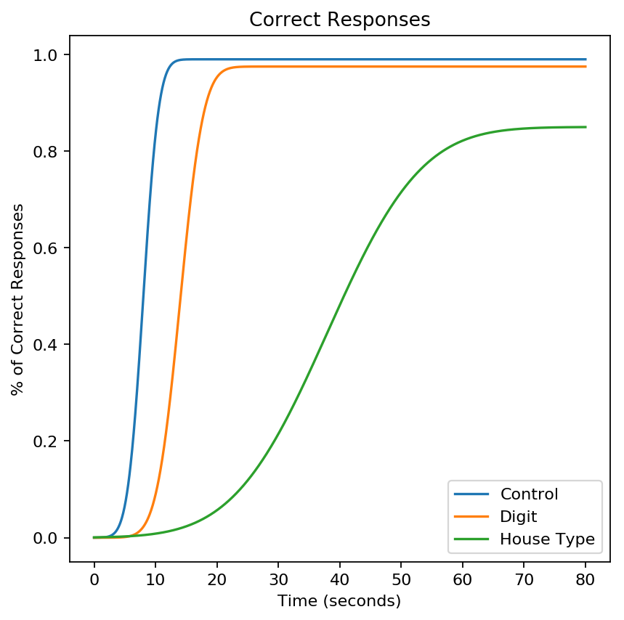
Hypotheses
Most participants will be able to solve the puzzles even with such a simple tutorial
There may be a drop-off in asymptotic accuracy for the various conditions
There may be an increase in mean and SD of time taken to complete puzzle
Notes:
max_time = 80
x = np.linspace(0, max_time, max_time*20)
ctrl_m = 8
ctrl_s = 2
ctrl_acc = .99
ctrl_cdf = cdf(x, ctrl_m, ctrl_s)*ctrl_acc
digit_m = 14
digit_s = 3
digit_acc = .975
digit_cdf = cdf(x, digit_m, digit_s)*digit_acc
type_m = 38
type_s = 12
type_acc = .85
type_cdf = cdf(x, type_m, type_s)*type_acc

Slide 19
Interpretations
If participants can solve the puzzles, evidence suggests fungibility
If mean of solving times and accuracies differ for different conditions, evidence suggests task-specificity of fungibility, i.e. fungibility is not binary

Slide 20
Things to Consider
Two other techniques (after piloting Hidden Singles)
More controlled conditions to account for
Number of variations imposed
rather than cumulative, maybe just swap 1 or 2 things from the tutorial
Order effect: swap the order of conditions
Variance in difficulty: Generate puzzles by exploiting group symmetries
Hints and directing attention

